Slide 1
MSCA Time Series Analysis:
PJME Energy Consumption Prediction
Richard Yang
Notes:
P2-4 Richard 1.5min
P5-P8: Han 1.5min
P9-P14: Rich: 2.5min
P15-17: Han: 1.5min
P18-20: Richard: 2min
P21-P23: Sam BSTS+Comparison 2.5min
P24: Conclusion:1min

Slide 2
Agenda
1
2
3
4
Business Problem
Data Overview & EDA
Data source
Data cleaning
Seasonality
Hypothesis Test
Model Approaches & Comparison
Baseline (LR + TSLM)
Exponential Smoothing
Dynamic Harmonic Regression
sARIMA
Bayesian Structural Time Series
Conclusion & Recommendations
Notes:
The historic plunge in global energy consumption in the early months of the Covid-19 crisis last year drove the prices of many fuels to their lowest levels in decades. But since then, they have rebounded strongly, mainly as a result of an exceptionally rapid global economic recovery (this year is on track for the fastest post-recession growth in 80 years). Higher energy prices have contributed to painfully high inflation, pushed families into poverty, forced some factories to curtail output or even shut down, and slowed economic growth to the point that some countries are heading towards severe recession.

Slide 3
Why is Energy Consumption Critical?
Important Macroeconomic Indicator
Households Financial Pressure
Unstable Consumption Quantity
Following the pandemic, there has been a surge in energy consumption, leading to elevated prices. This, in turn, has contributed to heightened inflation rates and triggered economic recession.
About 20% of U.S. households have missed or made a late payment on their utility bill in the last month. Families with an income of $50,000 or less are struggling the most to absorb higher energy costs.
The energy sector is characterized by significant fluctuations due to supply-demand imbalances, geopolitical tensions, and other macroeconomic factors. Therefore, it is very challenging to construct a robust model to provide accurate predictions.
Source
Notes:
The historic plunge in global energy consumption in the early months of the Covid-19 crisis last year drove the prices of many fuels to their lowest levels in decades. But since then, they have rebounded strongly, mainly as a result of an exceptionally rapid global economic recovery (this year is on track for the fastest post-recession growth in 80 years). Higher energy prices have contributed to painfully high inflation, pushed families into poverty, forced some factories to curtail output or even shut down, and slowed economic growth to the point that some countries are heading towards severe recession.

Slide 4
Benefits of Understanding Trend
01
Optimize purchase decisions.
Minimize operational expenses.
Boost overall profitability.
Cost Savings
02
Align operations with price trends.
Maximize productivity during low costs.
Enhance financial forecasting accuracy.
Strategic Planning
03
Outperform market peers.
Enhance brand trustworthiness.
Secure favorable contract terms.
Competitive Advantage
04
Hedge against price swings.
Reduce financial exposure.
Proactively manage market volatility.
Risk Mitigation
Notes:
Cost Savings: Accurate price forecasts allow businesses to make timely purchasing decisions, potentially saving millions annually.
Strategic Planning: Energy-intensive businesses can plan their operations more efficiently, maximizing productivity during periods of lower energy costs.
Competitive Advantage: Firms that can accurately predict and navigate energy price fluctuations can achieve better margins and market positioning.
Risk Mitigation: Predictive insights help businesses hedge against unfavorable price movements and manage their financial exposure.
Objective:
Develop a robust time series model that provides accurate short-term and long-term energy price forecasts, integrating multiple data sources and accounting for the multifaceted drivers of price variation.

Slide 5
Data Overview
Contains hourly energy consumption from 2002 to 2018
PJM Interconnection LLC (PJM)
1
2
2 columns (energy & time), 145k hourly observations -> 200 months
(after transformation)
Data Size
3
Data Cleaning & downsampling
Inconsistent, missing data at certain hour/month (e.g. 2008-March massive missing data)
4
Train / Test Split
Train 75%, Test 15% (36 months)
Notes:
PJM Interconnection LLC (PJM) is a regional transmission organization (RTO) in the United States. It is part of the Eastern Interconnection grid operating an electric transmission system serving all or parts of Delaware, Illinois, Indiana, Kentucky, Maryland, Michigan, New Jersey, North Carolina, Ohio, Pennsylvania, Tennessee, Virginia, West Virginia, and the District of Columbia. The hourly power consumption data comes from PJM's website and are in megawatts (MW).
Initially, we have 145k hourly observations. However, we found serious missing value issue that data for certain periods of time is missing. The issue affects certain hours, days or even months. We assume this is due to errors of data management or power outage (which is not marked or labeled, so it is difficult to track)
This brings difficulty to take hourly/daily average. So, eventually we decided to take the monthly mean of the data and ended up having 200 months.

Slide 6
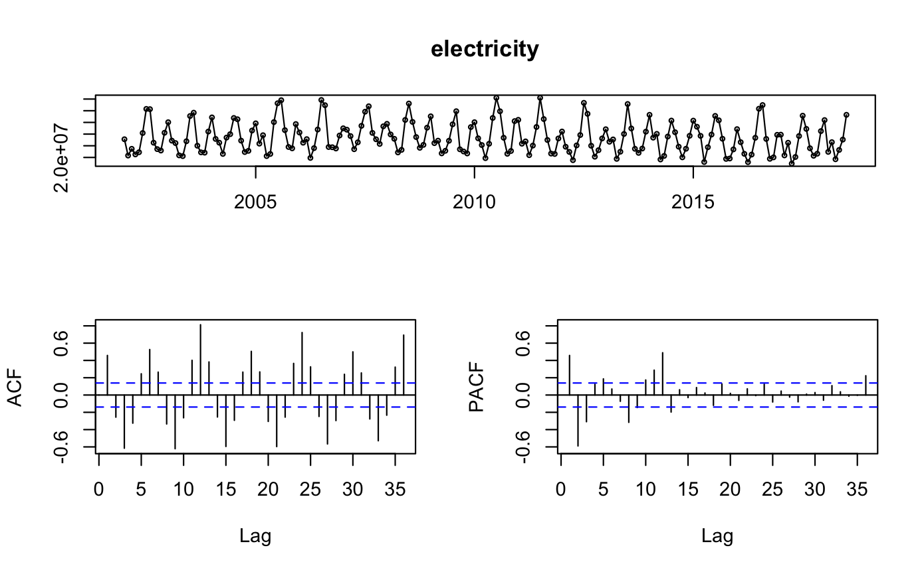
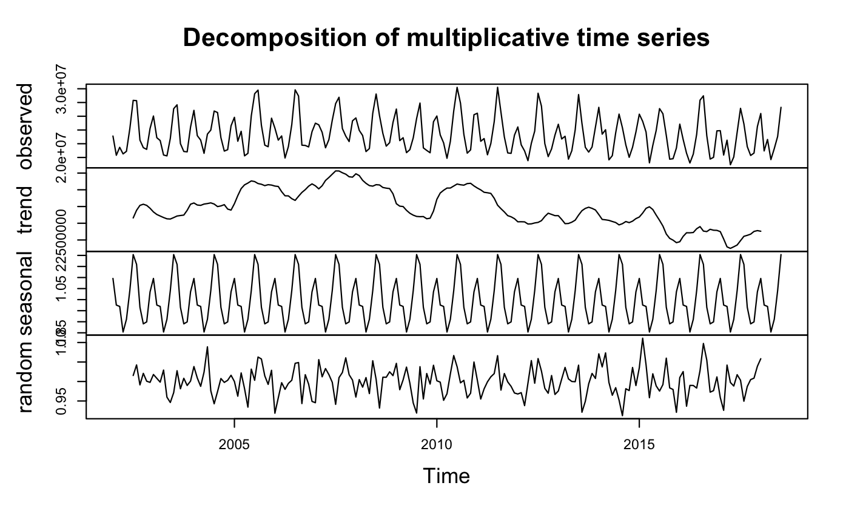
EDA: ACF, PACF, Trend
The PJME monthly average electricity consumption has:
a seasonal pattern (six month)
a declining trend (also see U.S. Energy Information Administration report)
Notes:
From these two plots above, we can see that the data has a slightly declining trend and a 6-month seasonality.
The trend is anti-intuitive,
however, we checked the U.S. energy consumption, it is not that the energy consumption is not growing. Instead, it is the trend that ends up into a slower growth.
Also, we have to consider the contributions by sector (resident, commercial, & industrial) and seasonal variation (cooler summer or warmer winter)
See:
^ https://www.eia.gov/energyexplained/electricity/use-of-electricity.php#:~:text=Total%20U.S.%20electricity%20consumption%20in,year%20decreases%20occurred%20after%202007.

Slide 7
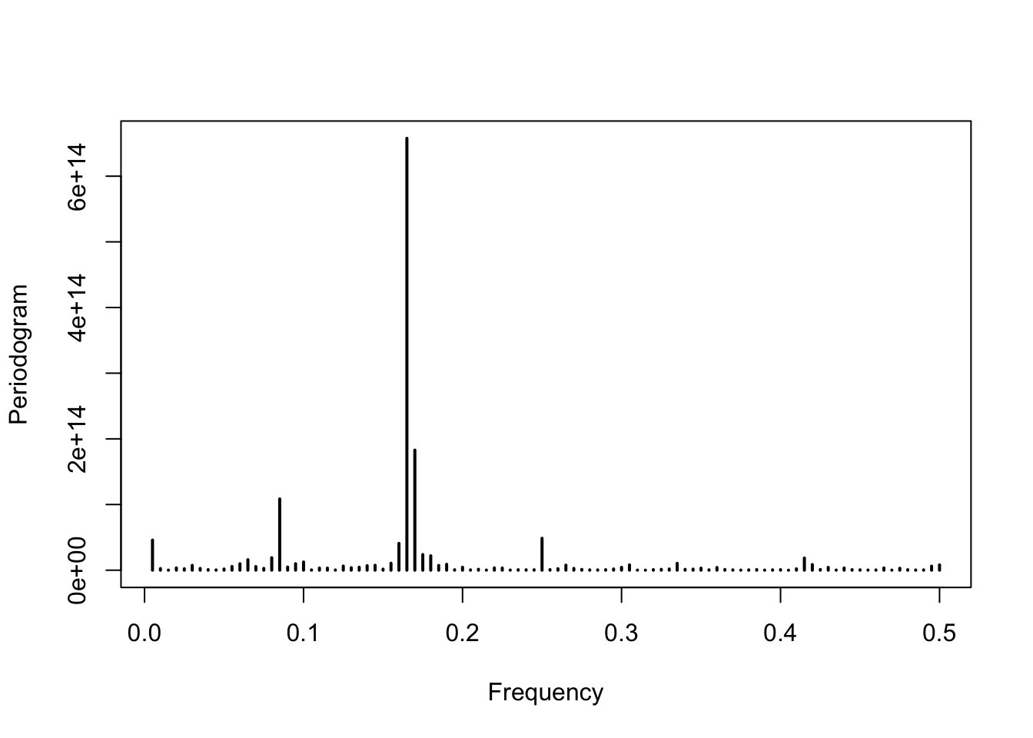
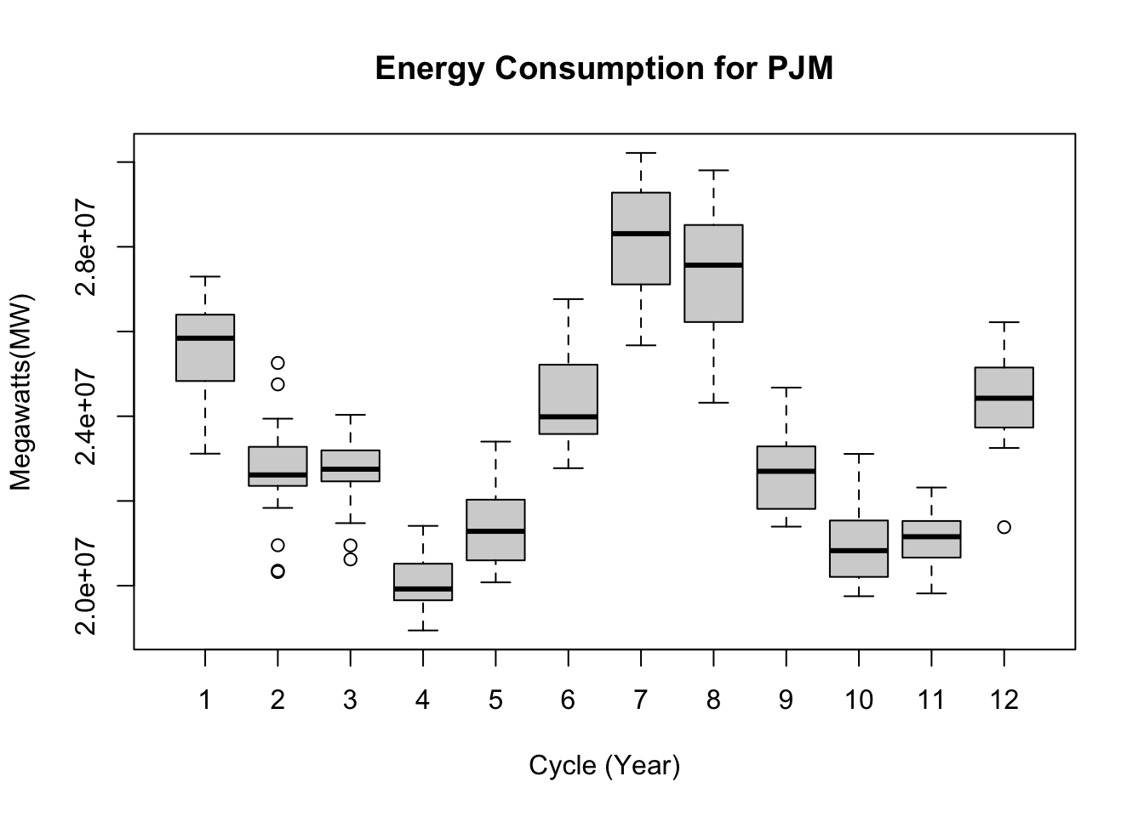
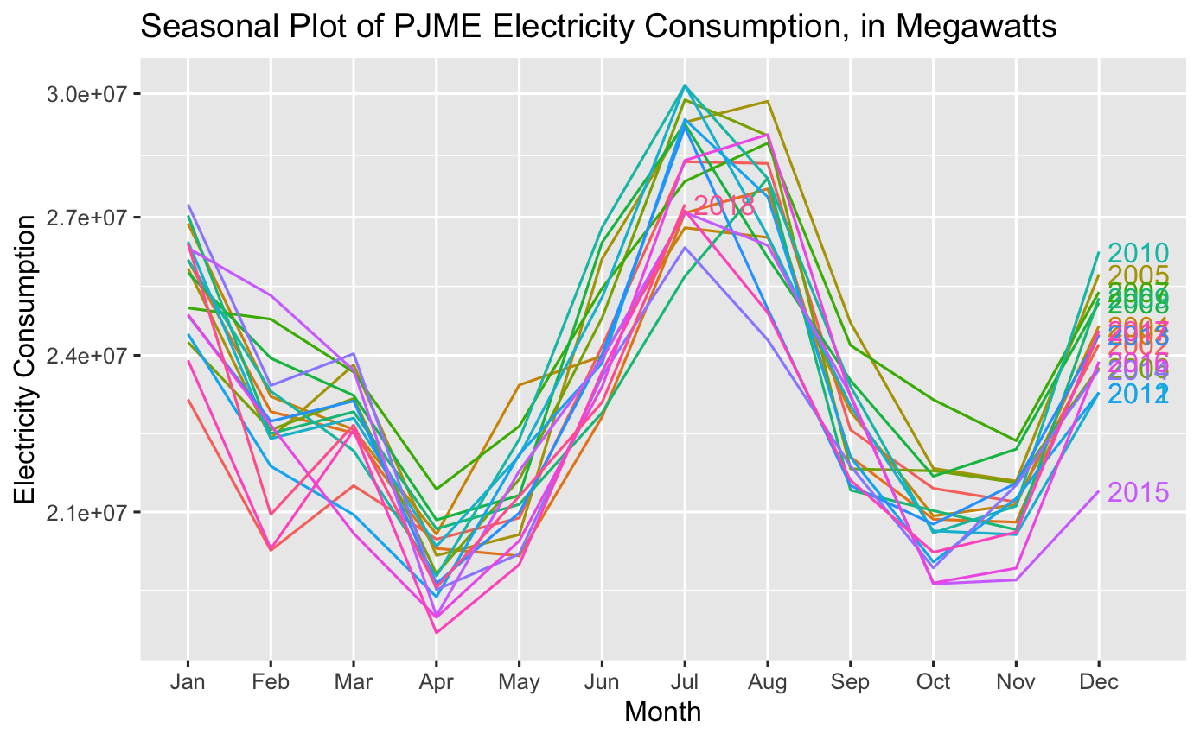
EDA: Decomposition,
Spectral Analysis
Periodogram - Dominant frequencies t = 0.165
Boxplot - Semi-annual electricity consumption peaksummer (June / July) and winter (Dec / Jan)
Seasonal plot - echoes boxplot, but also shows variation
Notes:
The semi-annual seasonality can also verify this by the spectral analysis, specifically, using the periodogram to identify the dominant periods (or frequencies). Here, f = 0.165, which corresponds to a period of 1/0.165 = 6 month.

Slide 8
EDA: Hypothesis Test
01
Stationarity
KPSS Level = 0.44894,
Truncation lag parameter = 4, p-value = 0.05606
02
Differenced Stationarity
KPSS Level = 0.024273, Truncation lag parameter = 4, p-value = 0.1
03
Stability
Box-Cox Lambda = 0.2452849
KPSS Level Stationary Test - p > 0.05, we cannot reject the null hypothesis which means that our data can be concluded as stationary
Box-Cox Transformation - a very slight downward shift with the level of the series
Notes:
According to the KPSS result, the p-value of the data is greater than 0.05. Thus, we cannot reject the null hypothesis which means that our data can be concluded as stationary. -> after differencing (lag=12), the series is more stationary and has a p-value =0.1 for KPSS test
In summary, a Box-Cox lambda value of 0.24 suggests applying a transformation that is similar to a square root transformation, with the goal of achieving a more symmetric and potentially more normally distributed dataset. Thus, we need the Box-Cox transformation to stabilize the variance.

Slide 9
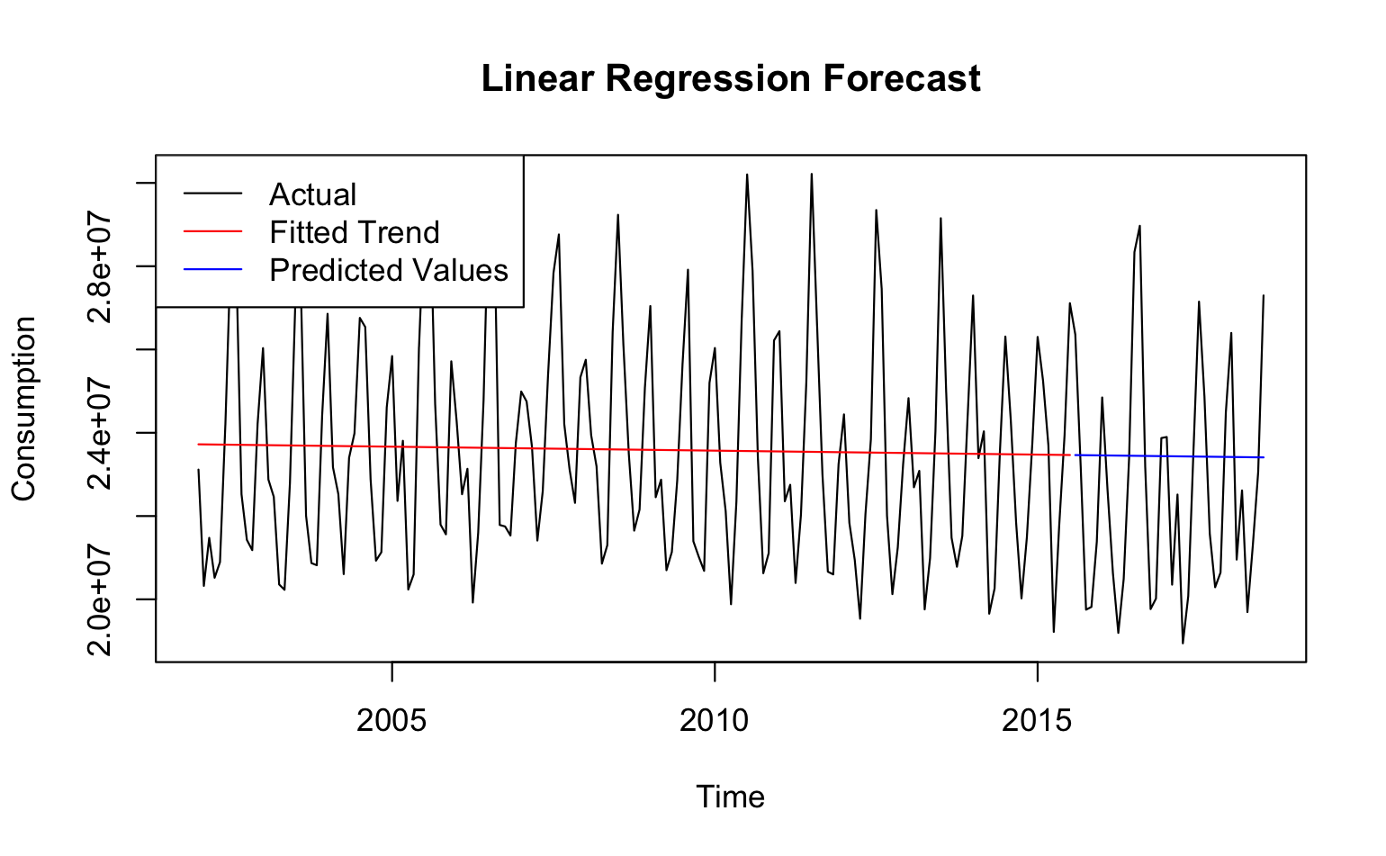
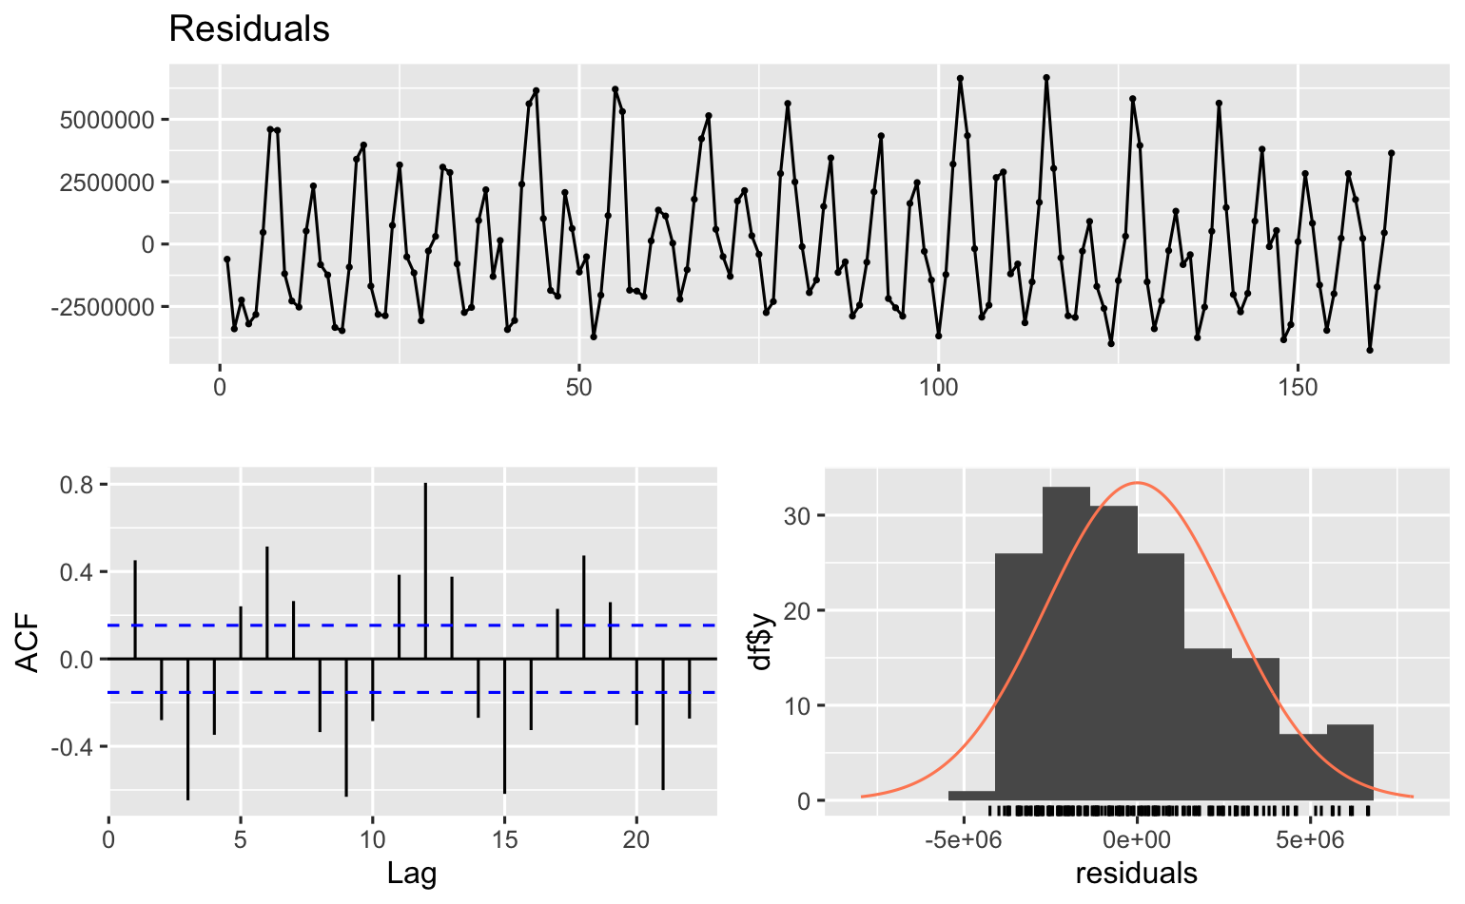
Linear Regression (LR):
Split Validation
RMSE | 2821861
MAE | 2391181
Since LR ignored seasonality, the model clearly failed to capture seasonal variations and we have residuals with seasonality as well
Notes:
I am going to introduce our first model using Holt-winters method, which is a exponential smoothing model and a specialized ets model. After looking at the variance, I decide to use the additive version of holt winters.
Here are the parameters of holt winters which we can divide into two part, the smoothing parameter and the initial state. One special thing is that gamma is 0, which means the seasonality component is only based on the lag m of itself, not the level.

Slide 10
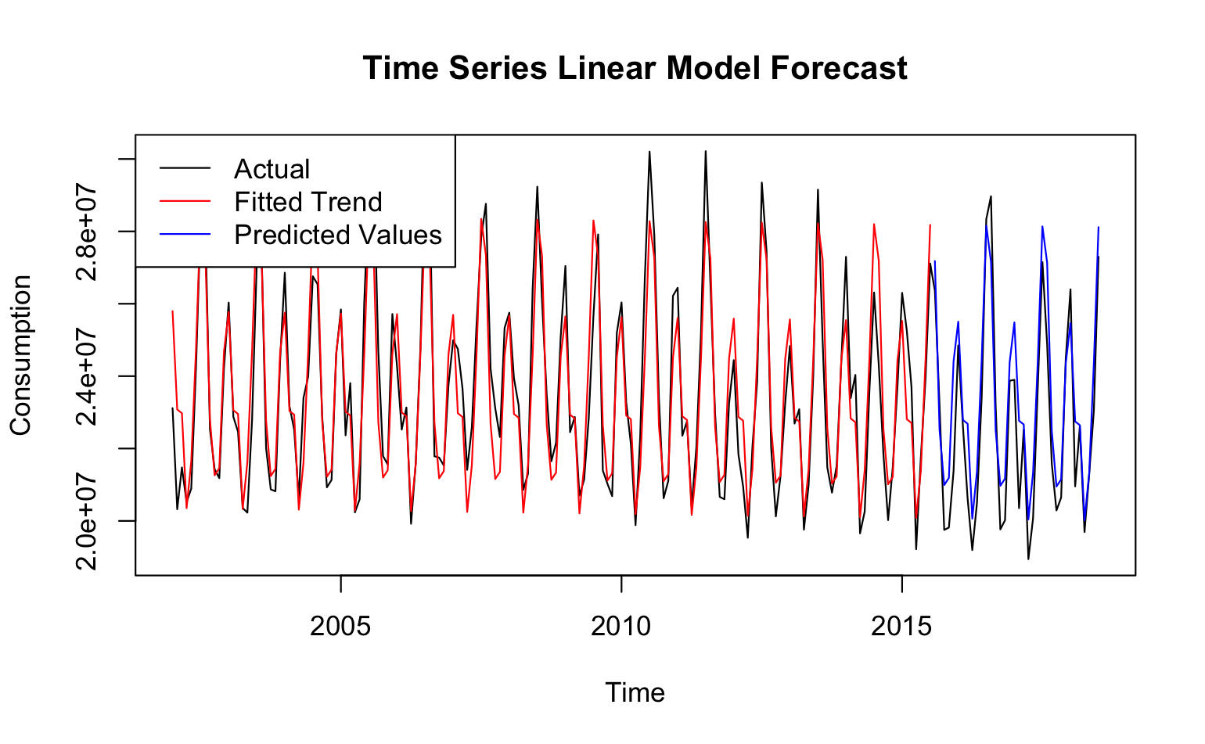
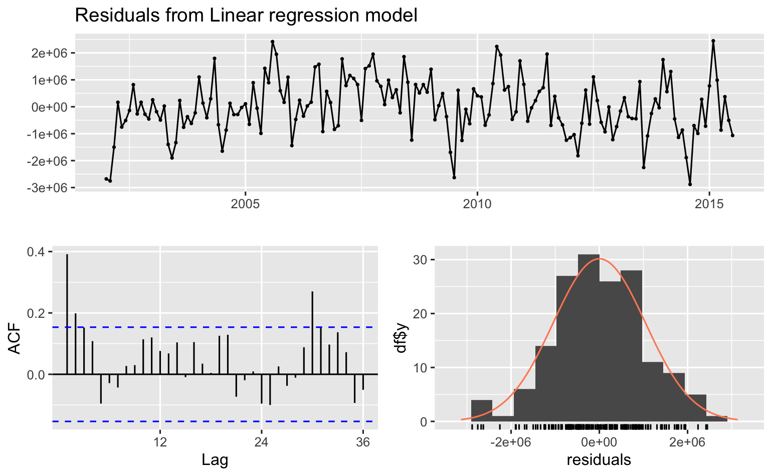
Time Series Linear Model (TSLM):
Split Validation
RMSE | 1220888
MAE | 1007208
TSLM is also experimented to incorporate seasonality. The prediction significantly improves and the residuals mostly resemble a white noise, which is a good improvement as a baseline model
Notes:
I am going to introduce our first model using Holt-winters method, which is a exponential smoothing model and a specialized ets model. After looking at the variance, I decide to use the additive version of holt winters.
Here are the parameters of holt winters which we can divide into two part, the smoothing parameter and the initial state. One special thing is that gamma is 0, which means the seasonality component is only based on the lag m of itself, not the level.

Slide 11
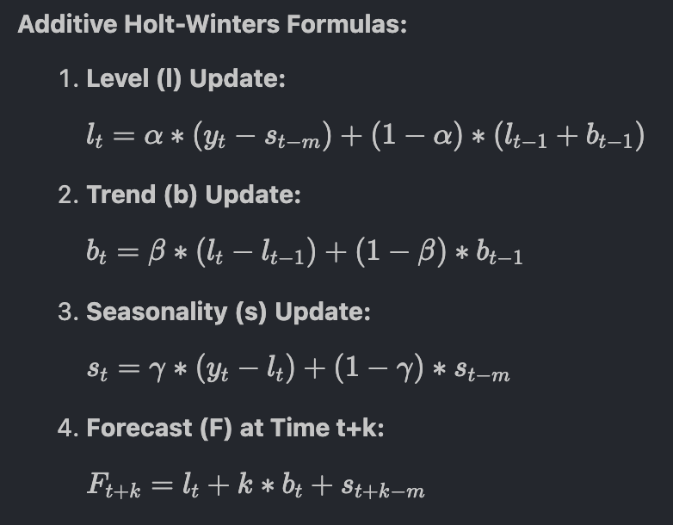
ETS: Exponential Smoothing
- Additive Holt-Winters
Smoothing parameters
alpha | 0.3042
beta | 0.0015
gamma | 1e-04
Initial states
l | 23163572.545
b | 36414.1843
s (m=12) | 926106.6, -2307248, -2434922, -974162.2, 3708332, 4814147, 1015599, -2084154, -3355885, -755715.7, -685822.6, 2133724
Using additive Holt-Winter since the variance is relatively stable
Notes:
I am going to introduce our first model using Holt-winters method, which is a exponential smoothing model and a specialized ets model. After looking at the variance, I decide to use the additive version of holt winters.
Here are the parameters of holt winters which we can divide into two part, the smoothing parameter and the initial state. One special thing is that gamma is 0, which means the seasonality component is only based on the lag m of itself, not the level.

Slide 12
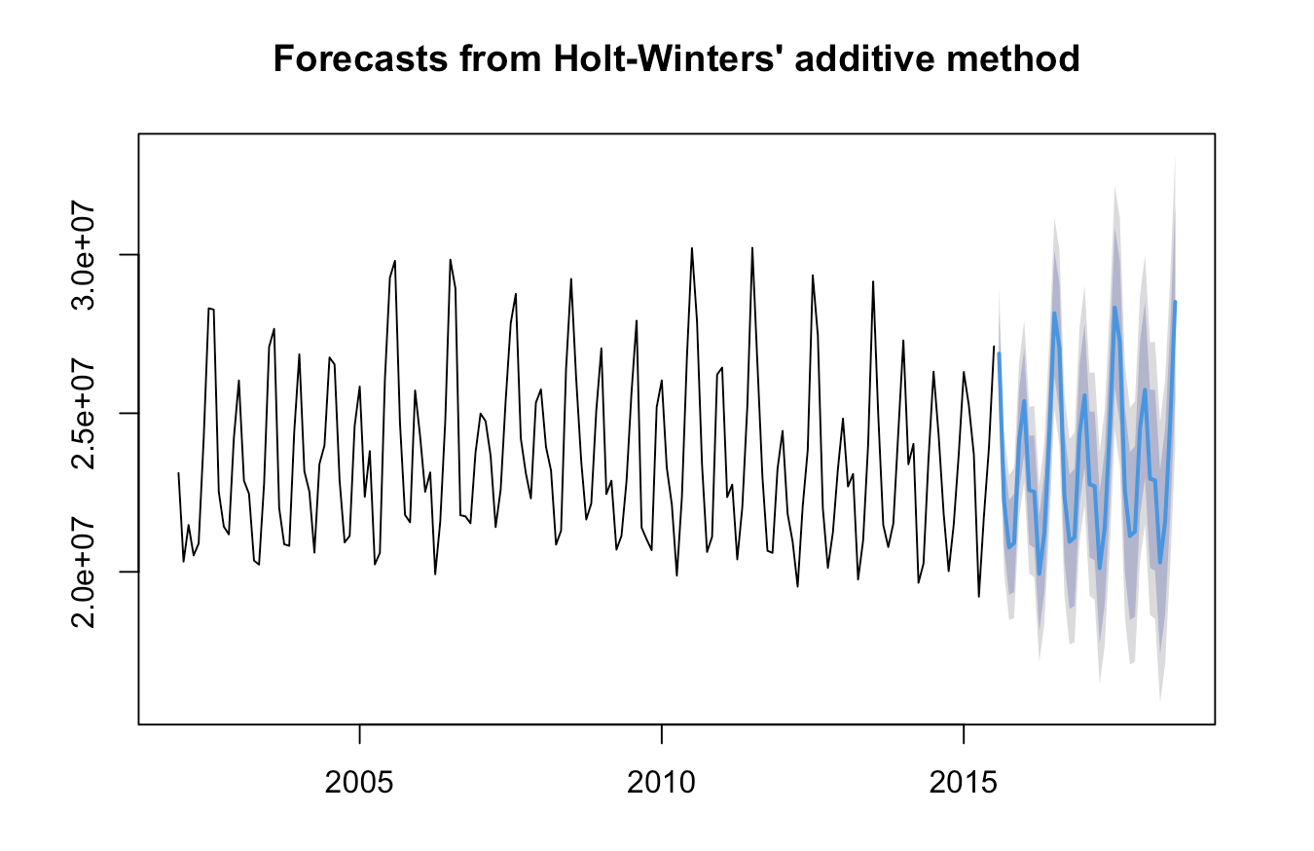
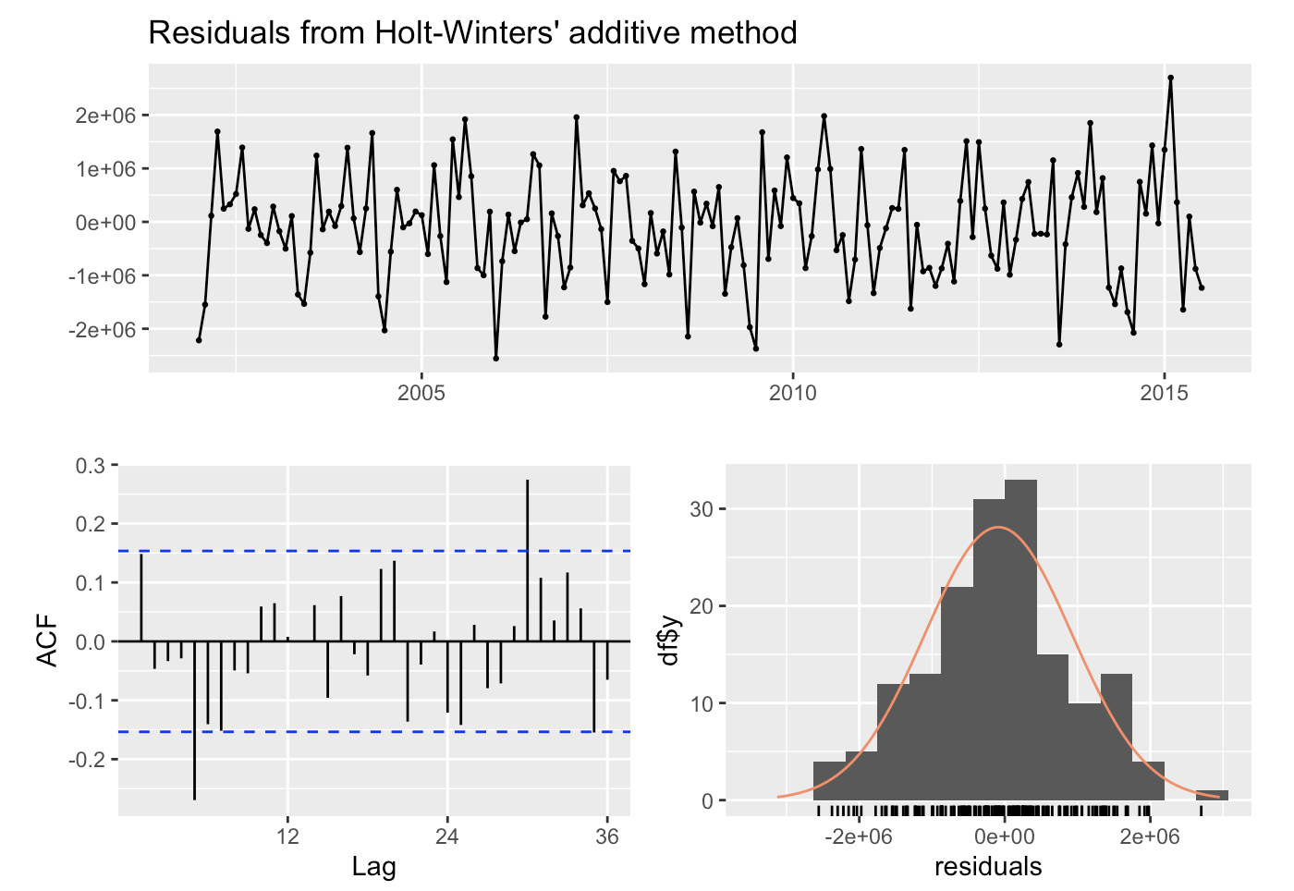
ETS: Evaluation of HW Model
AIC | 5360.97
AICc | 5365.191
BIC | 5413.564
The ACF plot seems to have autocorrelation issue
Notes:
From the plot of the forecast, we can see the trend is quite reasonable, which follows the previous pattern, and the AIC score is about 5000. But when we look at the residuals, we can see that there is some degree of autocorrelation from the ACF plot.

Slide 13
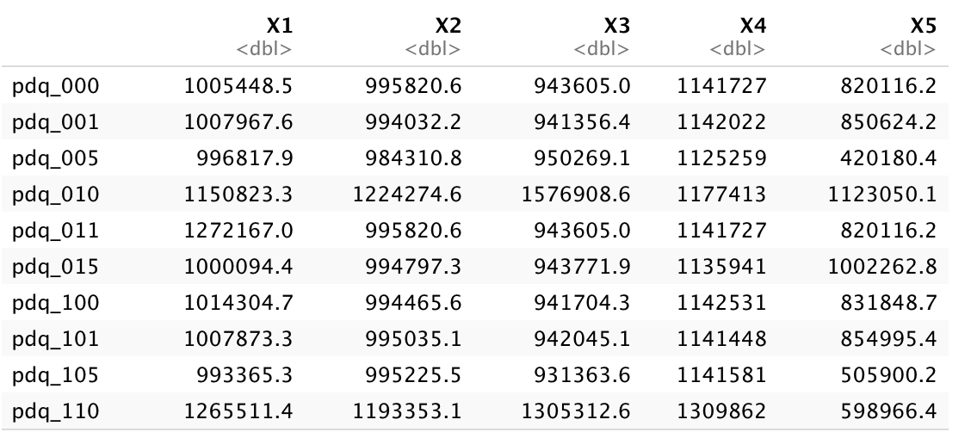
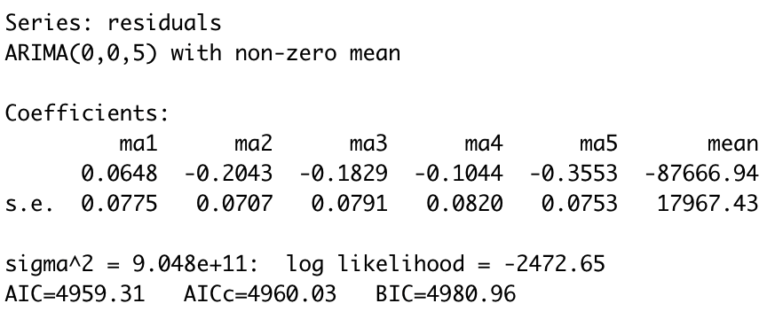
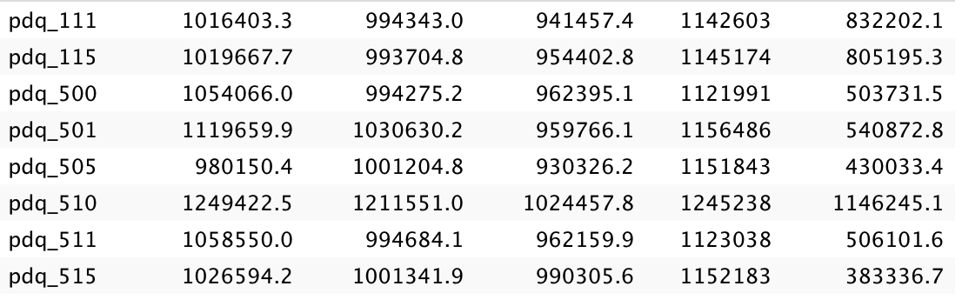
ETS: Fix Autocorrelation - ARIMA with CV
RMSE of CV[5]
Apply a five-fold expanding window approach to cross-validation.
Aggregate the windows of RMSE to decide best ARIMA model
ARIMA(0,0,5)
Notes:
To fix autocorrelation, I decide to use Arima to model the residual and use cross validation to see which parameters have the best performance. The cross validation method I use is expanding window method. The reason behind that is because the trend of our data is relatively stable, so aggregate more past information might help the model learn better.
Here are the RMSE score of each window with different combination of pdq, after aggregating all the window, I decide to use ARIMA(0,0,5) since it has the best aggregated rmse and lowest number of parameters. And we can also conclude that the residuals are best captured using an MA model with q=5.

Slide 14
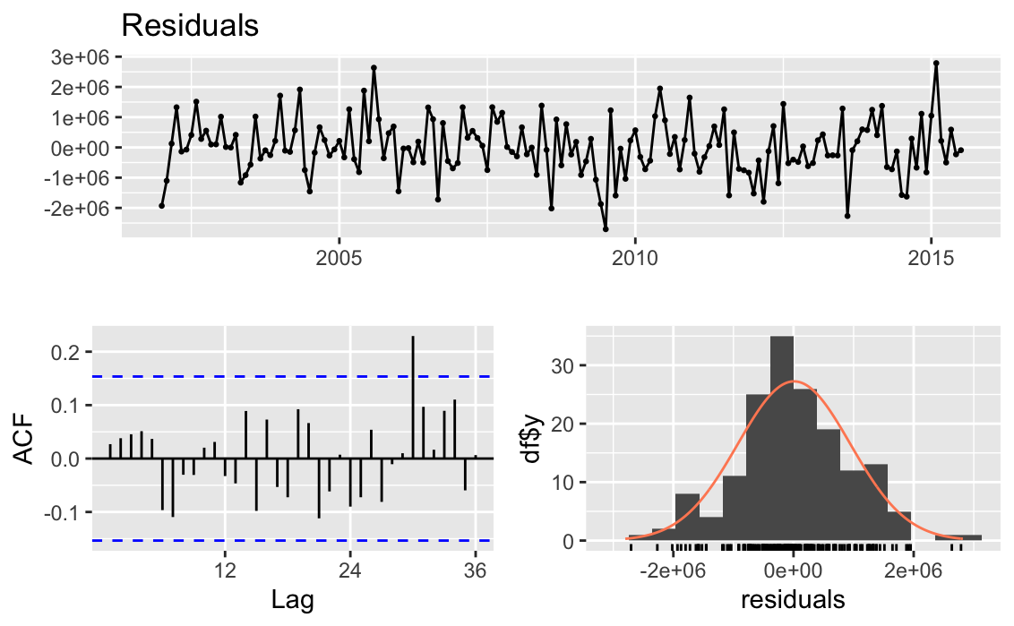
ETS: Residual after HW + ARIMA(0,0,5)
Less autocorrelated
Residuals ~ Normal distribution
Ljung-Box test
p-value: 0.6463
Notes:
After fixing, you can see that the ACF plot of residuals looks less autocorrelated, and the ljung box test has a p-value of 0.64,which means we solve the autocorrelation problem.

Slide 15
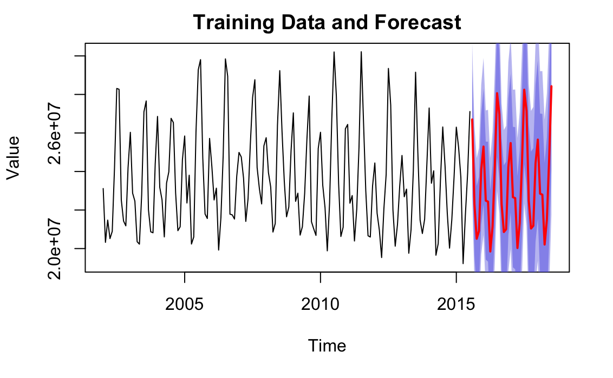
ETS: Prediction of Test Set
Test Set RMSE/MAE
HW method only
RMSE | 1232816
MAE | 1033276
HW method + ARIMA(0,0,5)
RMSE | 1175285.33
MAE | 970414.86
The confidence interval is larger than only with HW method
The RMSE and MAE of the combined model are lower than only with HW method
Notes:
This is the prediction after I combine both holt-winters and Arima model, you can see that compared to the original holt winters model, the confidence interval increases, but the mean of the prediction is still reasonable.

Slide 16
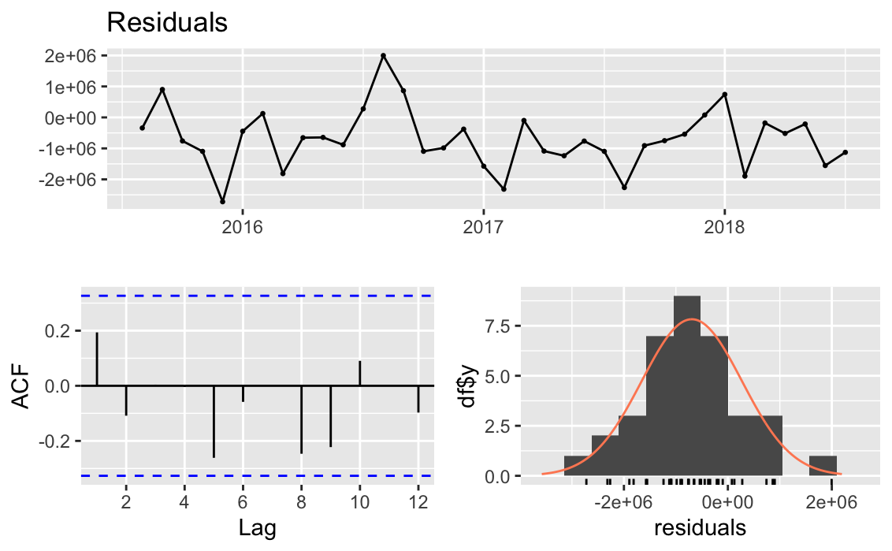
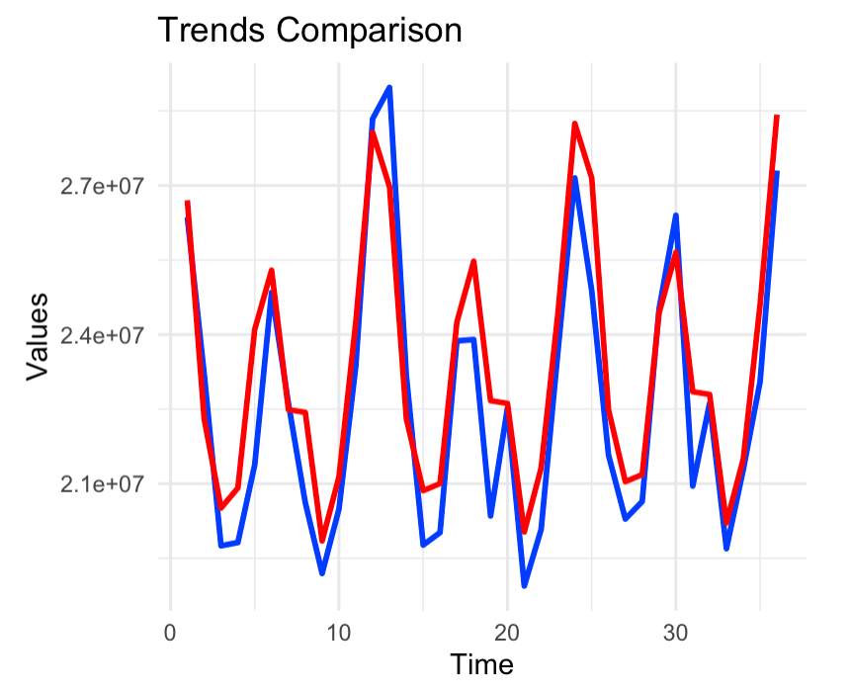
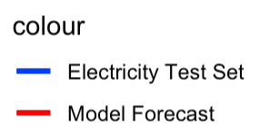
ETS: Evaluation of Test Set
No autocorrelation issue
Mean is not 0, which means the model might be biased
The predicted trend follow the actual data pretty well
Notes:
And I examine the characteristics of the residuals of the test set, and compared the actual data of the test set with the prediction. YOu can see that the model capture most of the trend and the peak and bottom of the result. The RMSE score of the test set here is about 1.1 million and the MAE is about 970k.
However, there is still an issue in this model since the distribution of the residuals is not center at 0, which means this is not an unbiased model.

Slide 17
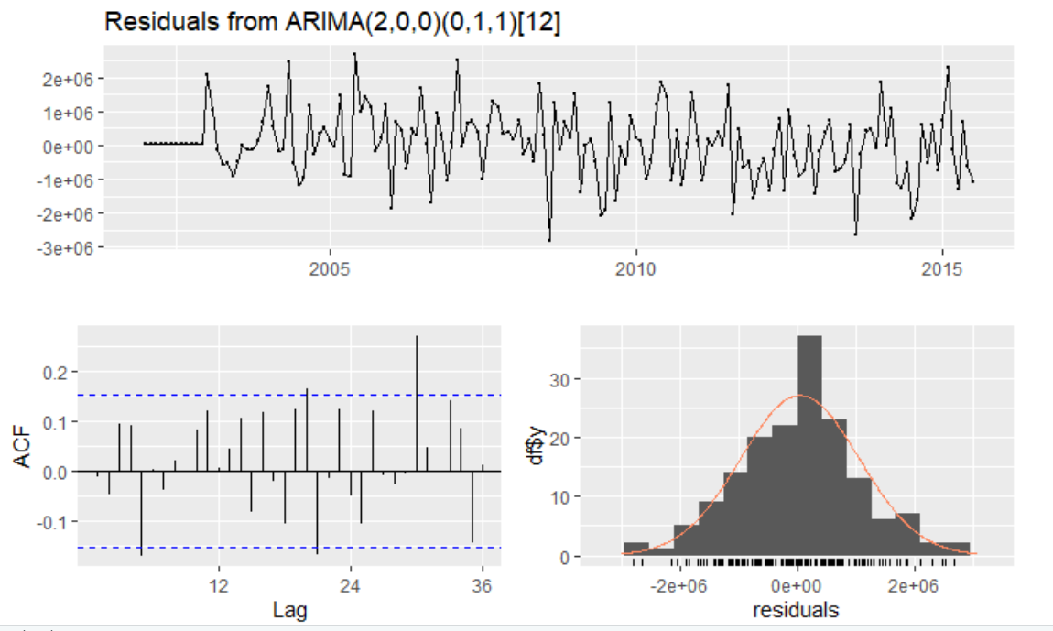
Seasonal ARIMA Model
RMSE | 1309595.63
MAE | 1068540.59
The ARIMA model includes an autoregressive term of order 2, indicating the current value is influenced by its two previous values.
There's no non-seasonal differencing or moving average component.
The model requires first differencing for the seasonally adjusted series every 12 periods.
Notes:
p-value = 0.0143

Slide 18
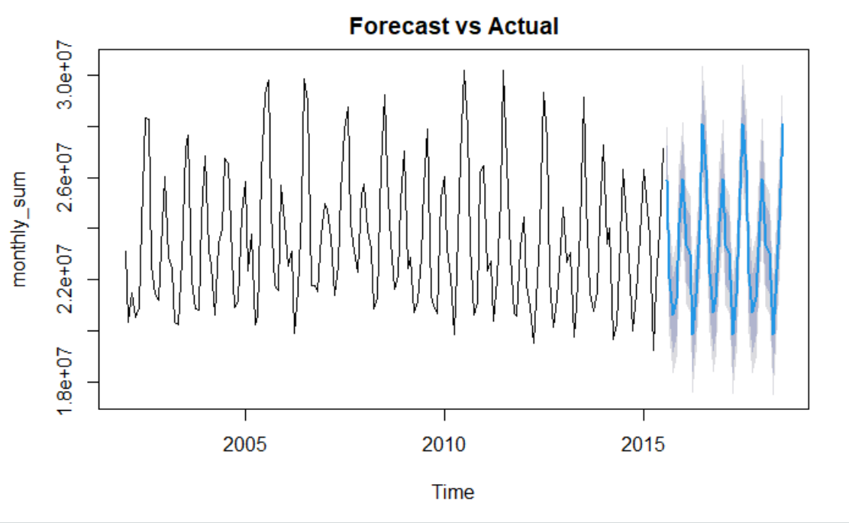
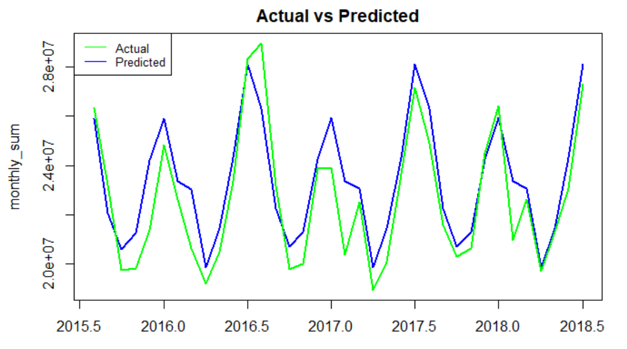
Seasonal ARIMA: Forecast Result
This ARIMA Model is capable of capturing the seasonality well especially the peaks and troughs.
However, sometimes it may become too insensitive in capturing the detailed changes.

Slide 19
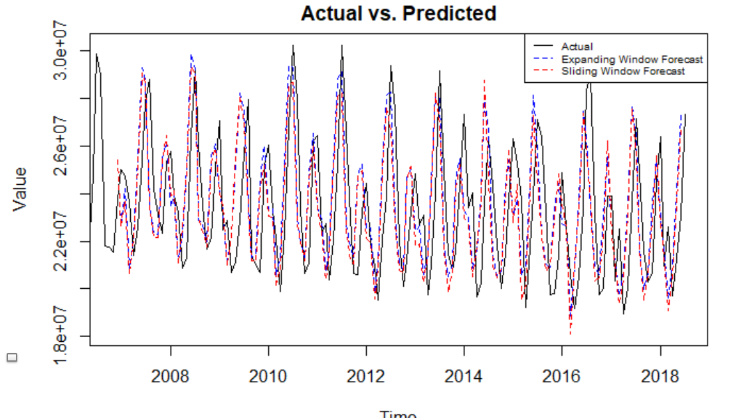
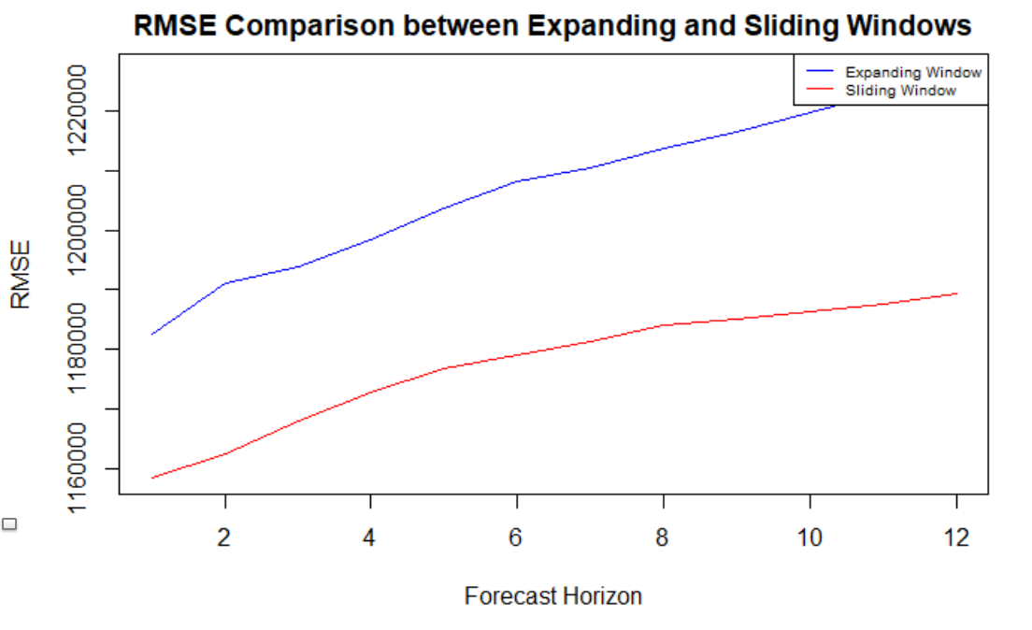
ARIMA: Sliding & Expanding Window
 | Expanding Window | Sliding Window
RMSE | 1207319 | 1177700
MAE | 983325.3 | 938397.1
The RMSE and MAE are both lower in Sliding Window ARIMA model.
The dynamic RMSE of Sliding Model over time tends to have a more stationary trend. It is more stable.
Older data might contain noise or anomalies that aren't representative of current trends. By focusing on recent data, the sliding window might avoid being influenced by this noise.
Since the data has strong seasonality, the sliding window might be more adaptive. It will be more sensitive to recent patterns than an expanding window.

Slide 20
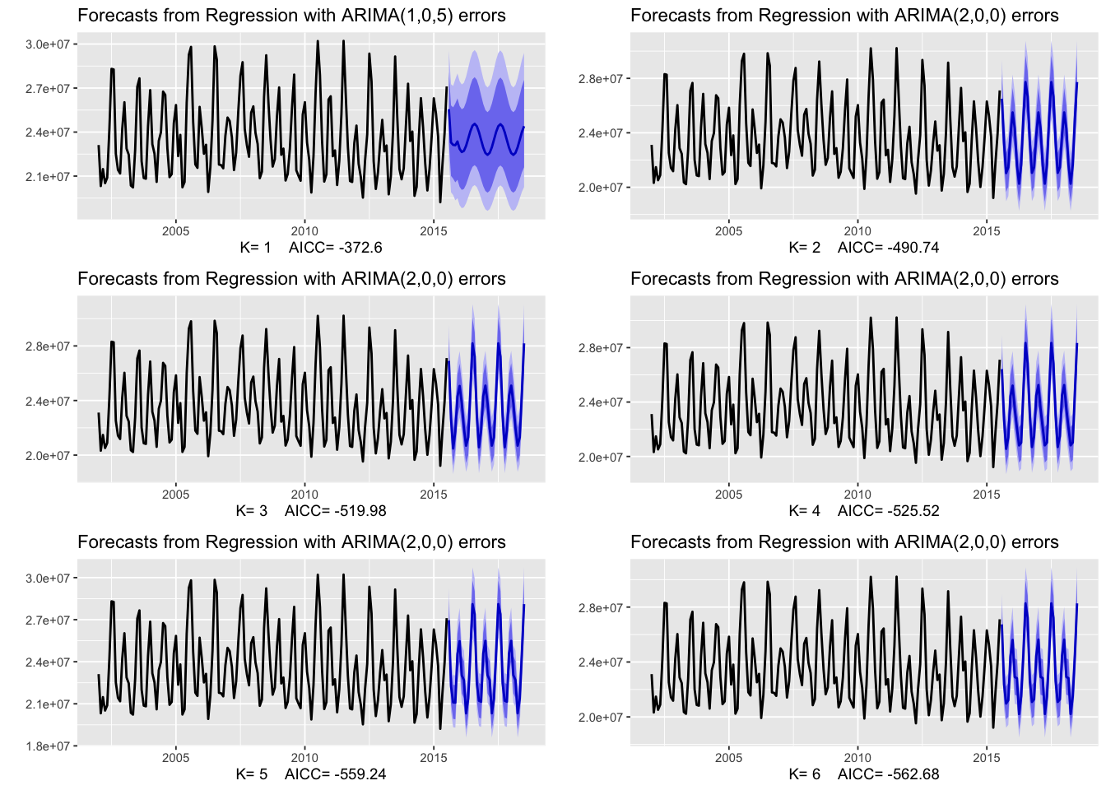
DHR: Dynamic Harmonic Regression with ARIMA errors
Best K | 2
Best ARIMA param | (2,0,0)
Auto ARIMA | (1,0,0)(2,0,0)[12]
Notes:
While we’ve seen the results from EDA and previous modeling sections that our data has a strong semi-annual seasonality, it came to our mind to test if there’s long-term seasonal periods – because one big contributor to electricity consumption is climate change, and climate changes in a longer period of time.
With that in mind, we experimented with dynamic harmonic regressions.
We’ve tested a few parameters for K so that we allow more “wiggly” seasonal pattern with simple ARIMA models. We also used auto ARIMA results as comparison.
Note: assumption
The only real disadvantage (compared to a seasonal ARIMA model) is that the seasonality is assumed to be fixed — the seasonal pattern is not allowed to change over time → but we think climate change seasonality is slow and thus is the energy consumption

Slide 21
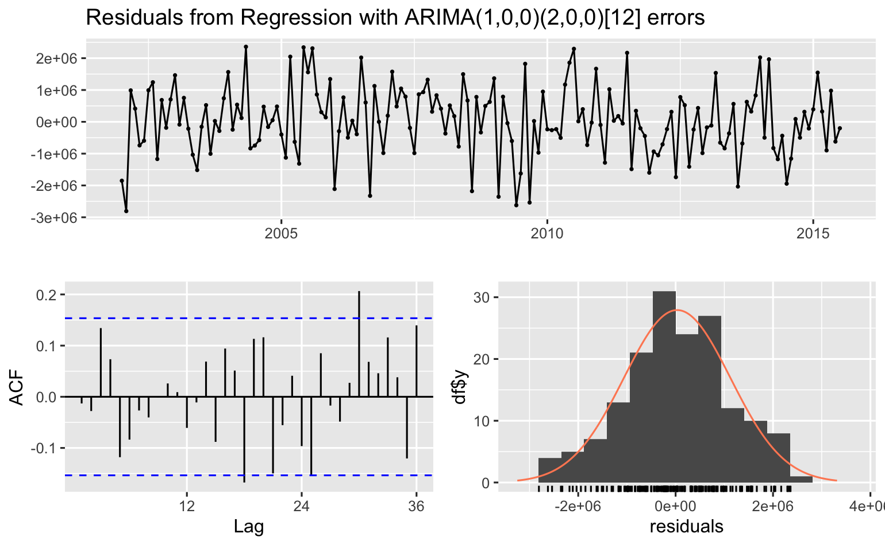
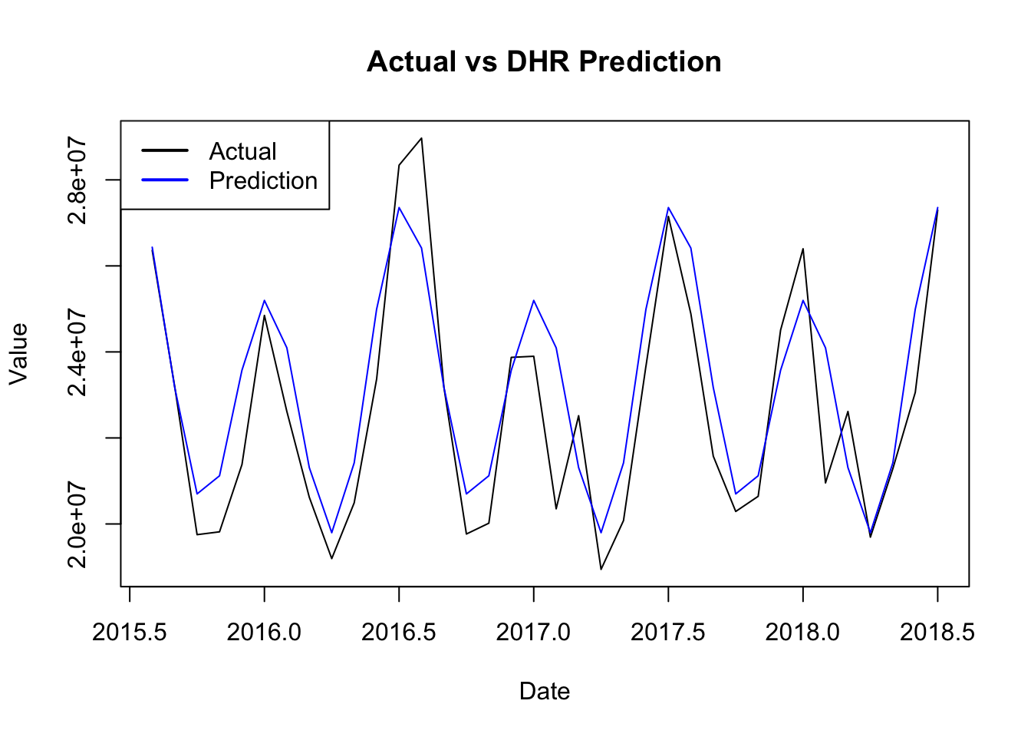
DHR: Split Validation
RMSE | 1540094.27
MAE | 1177421.18
The prediction result is much worse but the residuals follow the pattern of a white noise with most ACF values staying within the boundaries
Daily vs monthly: trade off of data, noise, and model memory
Notes:
After comparing their results (especially Ljung-box test and RMSE), we see that the results of DHR is worse than previous methods. One interpretation can be that the data we have does not have extremely long-term seasonality. However, the

Slide 22
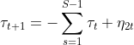
BSTS: Bayesian Structural Time Series
Mathematics behind BSTS
Basic equation:
Local level linear model:
Slope of Local:
Seasonal:
Autoregressive:
Errors:
Components of this BSTS model:
Local Linear Trend
Seasonal (12)
Auto AR Process (lag=6)
Source
Notes:
There are multiple components to BSTS, which allows for flexibility when designing a model for complex time-series.
For our data, I added a local linear trend, Seasonality of 12 (yearly), and an Auto AR Process of lag=6. I also added a prior, which is a residual SD prior.

Slide 23
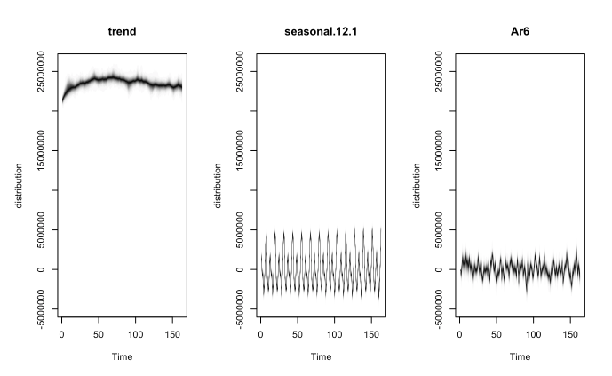
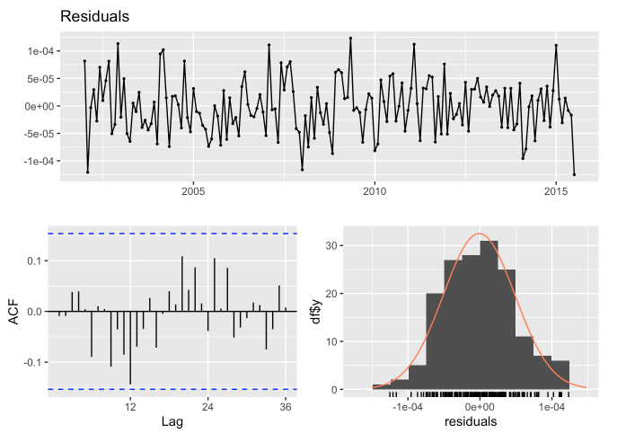
BSTS: Bayesian Structural Time Series
Ljung-Box test
p-value: 0.8875
Components of this BSTS model:
Local Linear Trend
Seasonal (12)
Auto AR Process (lag=6)
Notes:
There are multiple components to BSTS, which allows for flexibility when designing a model for complex time-series.
For our data, I added a local linear trend, Seasonality of 12 (yearly), and an Auto AR Process of lag=6. I also added a prior, which is a residual SD prior.

Slide 24
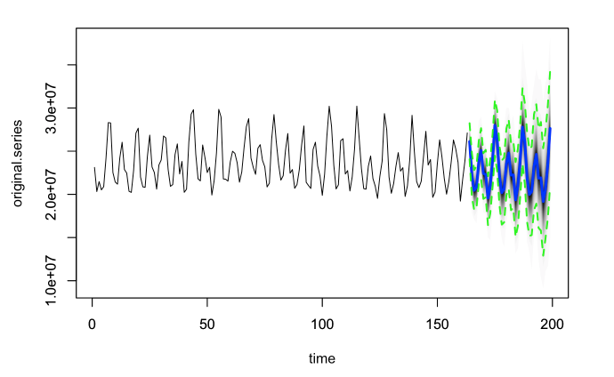
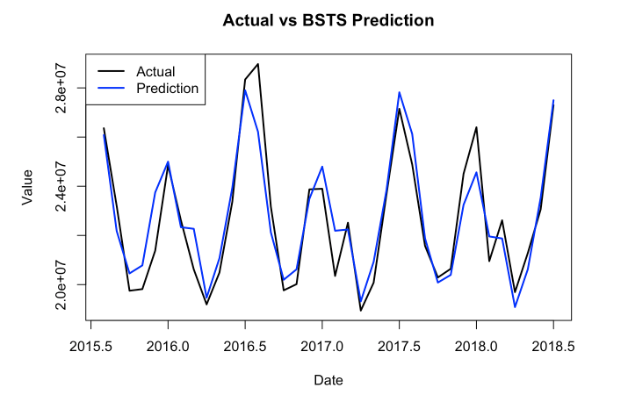
BSTS: Prediction Results
RMSE | 1002598
MAE | 787623
The bsts forecast shows a stochastic trend in longer forecast horizons, allowing greater uncertainty in future growth.

Slide 25
Model Comparison
Why BSTS has the best performance?
Flexibility and transparency to add components and fine tune
Can handle non-Gaussian distribution assumptions for the errors, better at capturing outliers
The MCMC draws from the posterior predictive distribution automatically account for model uncertainty
Why do other methods have worse performance?
Problem of ETS method is the model for test set is biased
DHR is more useful when addressing longer seasonal period, while our data has a shorter period of seasonality--and models like ARIMA is sufficient to handle
Models | RMSE | MAE
LR | 2,821,861 | 2,391,181
TSLM | 1,220,888 | 1,007,208
ARIMA | 1,177,700 | 938,397
ETS | 1,175,285 | 970,414
DHR | 1,540,094 | 1,177,421
BSTS | 1,002,598 | 787,623

Slide 26
Conclusion
Future Works
Future Works
Develop a predictive model for average of monthly energy consumption that accurately forecasts the energy usage pattern.
Enable energy providers, businesses, and households to plan for resource allocation, infrastructure upgrades, cost management.
Choose the BSTS model for optimal performance, minimal assumptions, and robust incorporation of uncertainty, enhancing its inferential capability
Future work includes predicting consumption in different scales such as daily, hourly data.
Incorporate additional explanatory variables, such as specific events like holidays or weather conditions.
Experiment with more components with the BSTS to get better performance
Notes:
The conclusion of our work is that we develop a predictive for monthly energy consumption, to solve the business problem about better resource allocation. The final decision of our model is bsts since it has the best performance and has robust assumption that we do not need to keep the dataset stationary. Future work includes that we could predict the consumption in different scales such as in a daily or hourly timefram to make the prediction more granular. And also incorporate additional variables such as weather conditions to make the model more comprehensive.

Slide 27
Appendix

Slide 28
Appendix: Contribution
 | ARIMA @Richard Yang | Exponential smoothing @Chenfeng Tsai | Bayesian Structural Time Series @Sam Zihao ding | Dynamic Harmonic Regression @Han Jiang
EDA (general) | Han Jiang Seasonality Trend Decomposition & Detrend ACF / PACF KPSS & Box-Cox Paradigm
Model Building & Training | ARIMA & SARIMA | Holt-winters + arima for residuals | BSTS | LR and TSLM DHR with auto.arima
Slide Deck | Modeling Business Problem | Modeling Conclusion | Modeling Model Comparison | Modeling EDA & Data Overview

Slide 29
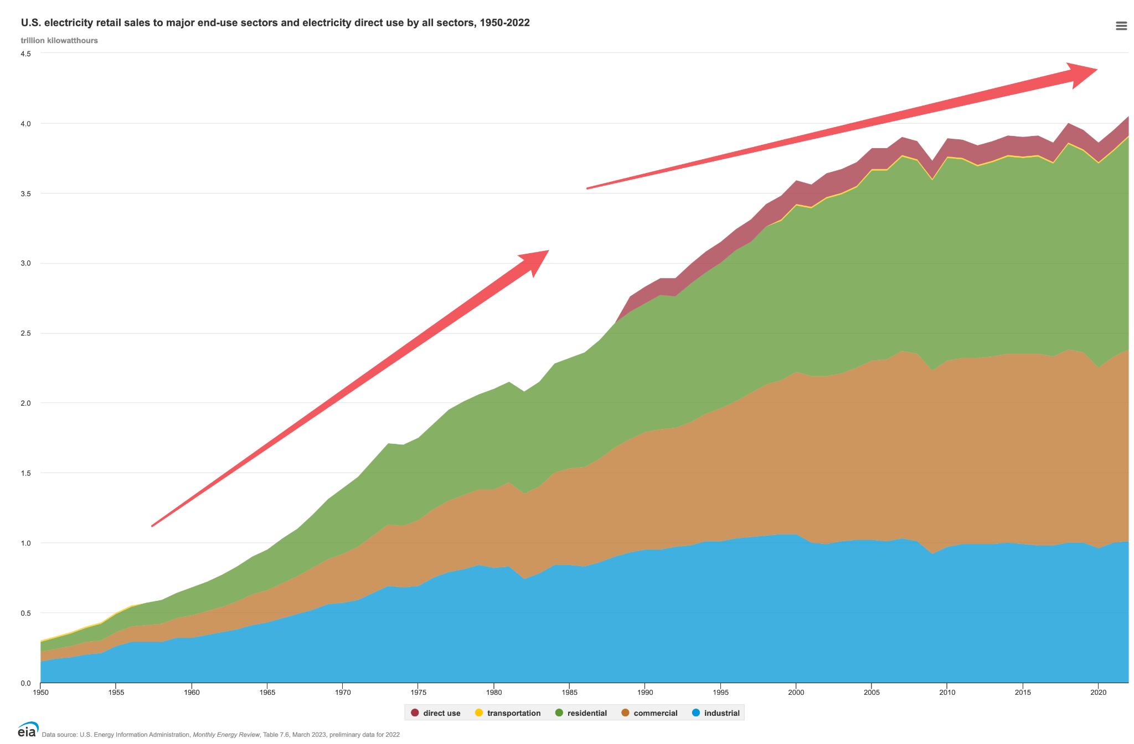
Appendix: U.S. Electricity Consumption by Sector

Slide 30
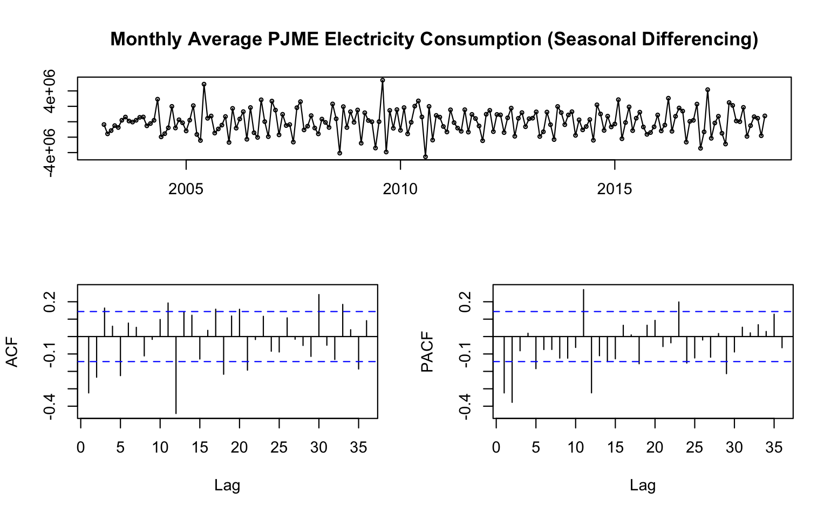
Appendix: Seasonal Differencing

Slide 31
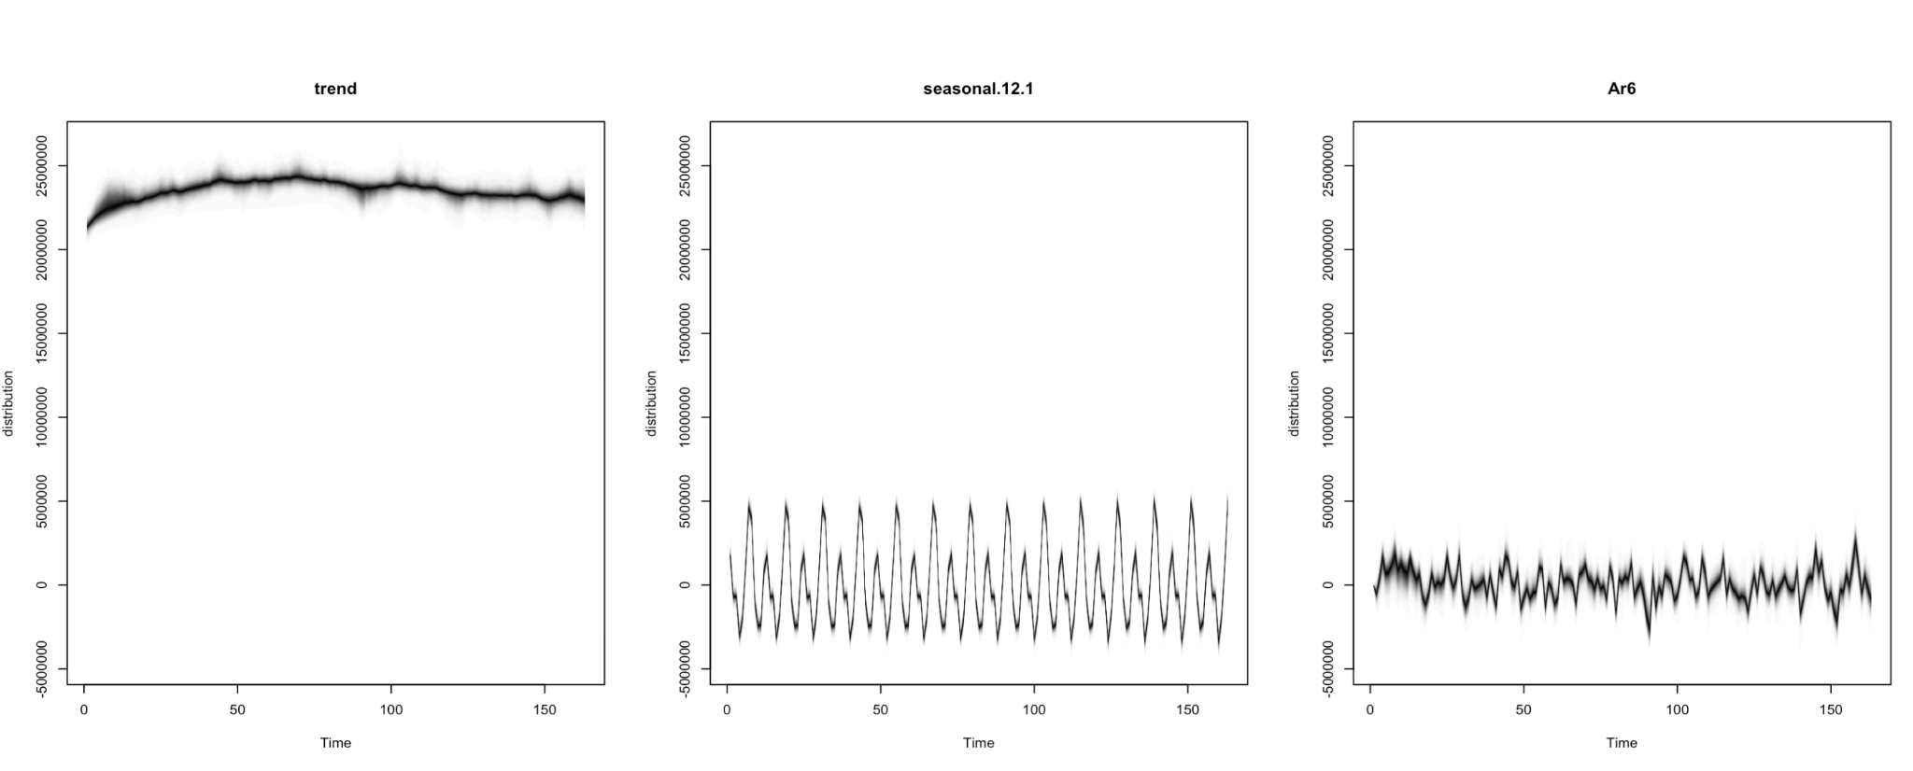
Appendix: BSTS Components

Slide 32
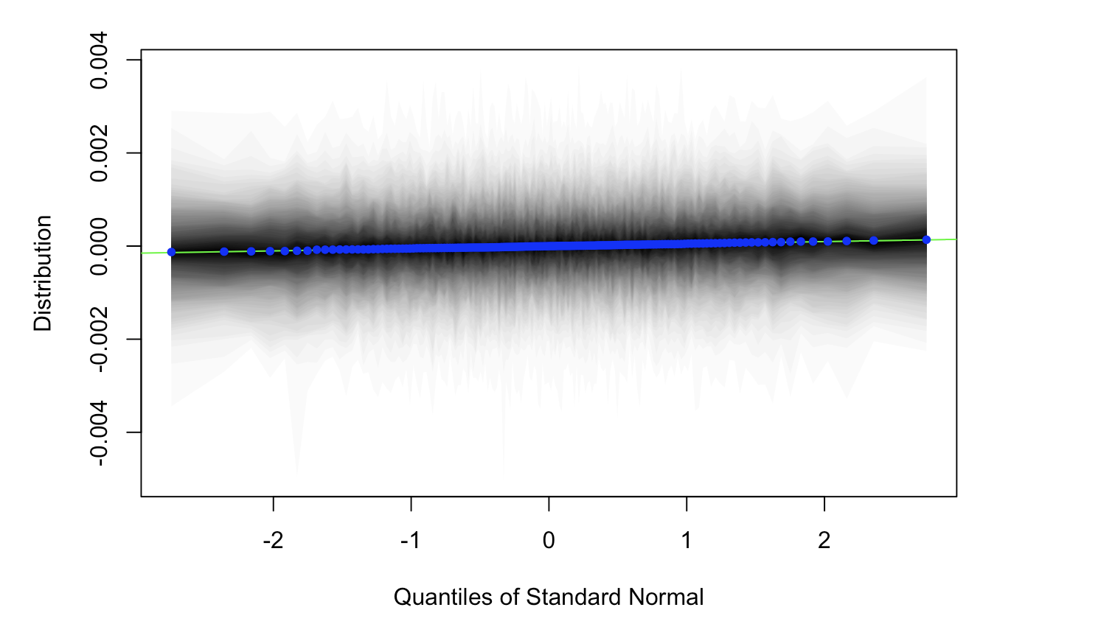
Appendix: QQ Plot for BSTS

